Slide 1
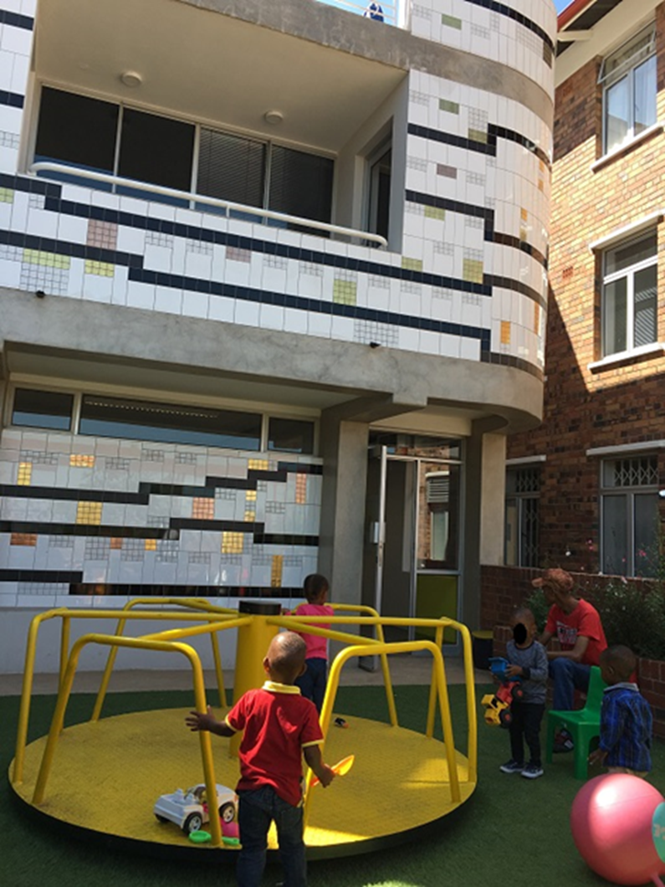
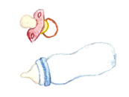
Neurodevelopment at 12 months of age
among very early treated infants in Johannesburg, South Africa
Renate Strehlau¹, Tamryn van Aswegen¹, Megan Burke¹, Louise Kuhn^{2, 3} and Joanne Potterton^{1,4}
¹ Empilweni Services and Research Unit, Rahima Moosa Mother and Child Hospital, Department of Paediatrics and Child Health, Faculty of Health Sciences, University of the Witwatersrand, Johannesburg, South Africa, ² Gertrude H. Sergievsky Center, Vagelos College of Physicians and Surgeons, Columbia University Irving Medical Center, New York City, NY, USA, ³ Department of Epidemiology, Mailman School of Public Health, Columbia University Irving Medical Center, New York City, NY, USA, ⁴Department of Physiotherapy, School of Therapeutic Sciences, Faculty of Health Sciences, University of the Witwatersrand, Johannesburg, South Africa
e-poster PEB0327
METHODS
Infancy and the period of early childhood are critical times for brain development.
HIV has the propensity to invade the central nervous system.
Perinatal HIV infection can have a significant impact on neurodevelopment.
Infant HIV infection can result in:
HIV-encephalopathy,
Delays in fine and gross motor development,
Receptive language delay,
Cognitive impairment,
Behavioural difficulties,
Poor school performance.
Initiation of suppressive paediatric antiretroviral therapy (ART) has been shown to attenuate, or even prevent, HIV-related neurodevelopmental consequences.
It is postulated that ART started early in the neonatal period will provide further neuroprotective benefits.
Early Childhood Development (ECD) programmes have been shown to positively influence developing brain architecture and long-term health outcomes, even into adulthood.
ECD programmes should include the five components of nurturing care: good health, adequate nutrition, responsive caregiving, opportunities for early learning, and safety and security.
Early childhood developmental interventions differ widely in their approach, duration, intensity and timing initiation.
ECD programmes are not routinely included in paediatric HIV management.
The aim of this study was to describe the neurodevelopment at 12 months of age of a cohort of infants infected with HIV starting ART in the early neonatal period, and partaking in a parentally-driven, home-based developmental stimulation programme.
In addition, the 12 month developmental outcomes were compared with a cohort of infants infected with HIV, also receiving ART started in the neonatal period, but not participating in the stimulation programme.
The home stimulation programme was initiated within the first month of life.
At birth, infants enrolled in the IG were provided a standardised set of age-appropriate, developmentally stimulating toys. Additional items were provided every three months through the first year of life (Table 1).
The child’s caregiver received an information card which was created in a South African setting as part of a developmental activity programme for use in children receiving outpatient care for cardiac disorders.
The information card included illustrations and information explaining what a child is expected to do at certain ages in terms of physical, cognitive, language and socio-emotional development.
Additional information included on the caregiver information card included information on how to stimulate the child, as well as warning signs which may indicate developmental delay.
A new information card was provided three monthly according to the age of the child.
The information contained in the caregiver information card was explained to the caregiver. Ideas on child play and stimulation using the toys provided were also discussed.
At 12 months of age, with a window of ± 4 weeks, children in the IG and OG were assessed using the Bayley Scales of Infant and Toddler Development (3rd Edition) (BSID-III).
Three developmental domains, namely, cognition, motor skills and language development were evaluated.
Two trained assessors conducted the assessments – a physician and a physiotherapist.
The BSID-III was conducted in English, and parents translated instructions to their children when needed.
Demographic and health-related variables were collected from birth through the study period.
RESULTS
BACKGROUND
Study Procedures
Table 2: Birth characteristics of the intervention and observation groups assessed using the Bayley Scales of Infant and Toddler Development (3rd Ed.) at 12 months of age
Table 4: Intervention and observation group BSID-III assessment scaled and composite scores for the cognitive, language and motor sub-scales at 12 months of age
 |  | Intervention Group |  | Observation Group | P value
 | N | 36 | N | 24
Male, n (%) |  | 17 (47.2%) |  | 12 (50%) | 0.8329
Gestational age (weeks), mean, (SD) |  | 38.42 (2.88) |  | 38.8 (1.64) | 0.5607
Gestational age ≤37 weeks, N (%) |  | 10 (27.8%) |  | 3 (12.5%) | 0.1593
Vaginal Delivery, N (%) | 35 | 23 (65.71%) |  | 18 (75%) | 0.4467
Breastfeeding initiated at birth, N (%) | 34 | 30 (88.2%) |  | 21 (87.5%) | 0.9325
Birth weight < 2499 (g), N (range) |  | 7 (1 290-2 410) |  | 6 (1 710-2 400) | 0.6088
Birth Z-scores, mean (SD)
Weight-for-age Z-score | 35 | -1.12 (1.32) |  | -1.36 (1.54) | 0.5241
Length-for-age Z-score | 34 | -0.09 (1.66) | 23 | -0.45 (2.14) | 0.4781
Weight-for-length Z-score | 33 | -1.37 (2.00) | 20 | -1.58 (2.21) | 0.7232
Head circumference-for-age Z-score | 35 | -0.38 (1.74) | 24 | -0.42 (1.81) | 0.9323
Age ART start (days), median (IQR) | 35 | 2 (1-9.5) | 24 | 3 (1-7) | 0.7188
HIV RNA VL (copies/mL) at time of ART start, median (range) | 28 | 74 950 (105-10 million) | 22 | 24 700 (100-1.74 million) | 0.7974
CD4+ T-cell count at time of ART start, median (range) | 33 | 1 990 (296-4 112) | 23 | 1 823 (215-5 000) | 0.9045
CD4+ T-cell percentage at time of ART start, median (range) | 33 | 42.74 (9.16-69.05) | 23 | 44.94 (18.29-62.96) | 0.6312
Assessment Subscale | Intervention Group | Observation Group | p
Age at time of BSID-III assessment (days), mean (SD) | 345.47 (66.2) | 352 (27) | 0.6535
Cognitive subscale Scaled Score, mean (SD) Composite Score, mean (SD) | 11 (2.57) 105 (12.84) | 11 (2) 103 (9) | 1.000 0.5252
Language Subscale Receptive Communication, Scaled Score, mean (SD) Expressive Communication, Scaled Score, mean (SD) Language Subscale, Composite Score, mean (SD) | 10.96 (2.35) 10.75 (2.08) 105.21 (2.35) | 9 (4) 10 (2) 100 (17) | 0.0331 0.1931 0.1904
Motor Subscale Fine Motor, Scaled Score, mean (SD) Gross Motor, Scaled Score, mean (SD) Motor Subscale, Composite Score, mean (SD) | 10.5 (2.08) 9.25 (2.10) 99.46 (9.24) | 10 (2) 10 (2) 99 (11) | 0.3833 0.1954 0.8705
Table 4:
At 12 months of age the Bayley-III assessment was conducted on 28 children in the IG (mean age 345.5 days, SD 66.2) and 24 (mean age 352 days, SD 27) in the OG.
For both groups the mean composite scores for the cognitive, language and motor subscales were within the test reference average range of 100 (SD 15).
The IG had higher composite score results in all three subscales (not statistically significant).
Within the language subscale, the mean receptive communication scaled score was significantly greater in the IG than in the OG (10.96, SD 2.35 vs. 9, SD 4, p=0.03).
One child in the OG was classified as showing developmental delay on the language subscale, achieving a composite score of 65 i.e. less than 2 SD subunits below the mean.
Table 1: Items provided to infants enrolled in the intervention group through the first year of life
Child’s age | Items provided
Birth | baby blanket, washcloth, baby booties, baby hat, rattle, plastic teething toy
3 months | small hand mirror, small plastic ball, baby book with thick pages, squeaky toy
6 months | ring stacker, large plastic ball
9 months | wooden blocks, plastic shape sorter, book with thick cardboard pages
12 months | wooden form board, small toy car, plastic doll, colourful picture book, large wax crayons, paper for drawing
OBJECTIVES
Table 2 and 3:
A total of 60 infants with HIV were enrolled at birth – 36 in the IG, 24 in the OG with an even distribution between male and female infants.
Although not significant, a greater number of infants in the IG were born premature at ≤37 weeks gestational age.
The mean anthropometric z-scores at birth all fell below the expected means for all values – weight, height and head circumference.
Breastfeeding was initiated in the majority of infants.
ART for the IG was initiated at a median age of 2 days (IQR: 1-9.5) and for the OG at 3 days (IQR: 1-7).
As anticipated, birth pre-treatment HIV RNA viral load (VL) values were high.
After 12 months, 28 IG infants remained in the cohort – 5 (13.9%) were lost to follow-up, 2 (5.6%) transferred out, and 1 (2.8%) died.
Mean length-for-age z-score worsened, but weight-for-length z-score improved in both groups.
No between group differences in HIV RNA VL or CD4% or absolute count at 12 months
CONCLUSION & KEY MESSAGES
Neurodevelopmental delays are common in infants and children infected with HIV.
Paediatric ART can attenuate or prevent developmental delays by controlling viral replication and subsequent damage to the developing central nervous system.
Programmes stimulating early childhood development markedly improve developmental outcomes in all children.
We found 12-month old infants infected with HIV and having started ART within the first week of life to achieve good scores when assessed using the Bayley Scales of Infant and Toddler Development (3rd Ed.).
However, in conjunction with having started ART at a very early age, at 12-months, infants having participated in a year-long, home-based developmental stimulation programme achieved higher scores on the cognitive, language and motor assessment subscales.
Comprehensive paediatric HIV care ought to include a developmental stimulation programme.
METHODS
Study Participants
New-born infants enrolled in the LEOPARD (Latency and Early neOnatal Provision of Anti-Retroviral Drugs) trial were co-enrolled in the early childhood stimulation trial.
Infants in the Intervention group (IG) took part in a 12-month programme designed to stimulate infant development.
The observation group (OG) received standard of care which did not include an ECD programme.
36 neonates participated in the ECD stimulation programme, of which 28 remained in follow-up for 12 months.
Both groups started ART in the early neonatal period as soon as the birth diagnosis had been confirmed.
Study follow-up took place at the Empilweni Services and Research Clinic, based at Rahima Moosa Mother and Child Hospital in Johannesburg, South Africa
Table 3: Characteristics of the intervention and observation group at 12 months age
Developmental Activity Programme
 | Intervention Group |  | Observation Group |  | P value
 | N |  | N
Male, n (%) | 28 | 16 (57.14) | 24 | 12 (50) | 0.6065
Duration on ART (days), mean (SD) | 27 | 346.12 (28.85) | 24 | 348.67 (23.69) | 0.7318
Z-scores, mean (SD)
Weight-for-age Z-score | 27 | -0.81 (0.93) | 24 | -0.55 (1.25) | 0.4002
Length-for-age Z-score | 27 | -1.10 (1.24) | 24 | -1.30 (1.19) | 0.5606
Weight-for-length Z-score | 27 | -0.34 (1.26) | 24 | 0.16 (1.14) | 0.1456
Head circumference-for-age Z-score | 26 | 0.29 (0.95) | 24 | 0.36 (1.07) | 0.8075
HIV RNA VL (copies/mL), median (IQR) | 22 | 36.5 (0-278.75) | 23 | 54 (0-3 330) | 0.3371
CD4+ T-cell count, median (IQR) | 19 | 2 155 (1 889.5-2 901.5) | 22 | 2 521 (2080-2843.25) | 0.3269
CD4+ T-cell percentage, median (IQR) | 19 | 32.88 (30.18-38.26) | 22 | 32.88 (30.18-35) | 0.6767
ACTIVITY GUIDELINE FOR INFANTS AND TODDLERS 0-3 MONTHS
What babies should do at this age:
Physical development:
When lying the baby moves arms and legs actively and the movements are smooth and rhythmical.
When held upright over your shoulder baby can lift their head for a moment.
When lying on their tummy baby can turn their head to both sides.
Is able to watch your face or a toy with their eyes when it is moved in front of their face.
Is able to bring both their hands to their mouth.
Learning, thinking and solving problems:
Pays attention to faces and recognises you.
Looks around.
Turns their eyes and head towards the side of the sound when a rattle is or someone speaks loudly.
Language and communication:
Smiles at the person speaking to them.
Coos and makes gurgling sounds.
Things you can do to help your baby’s development:
Talk, read, sing and play with your baby during feeding, dressing, and bathing.
Help your baby learn to calm herself. It’s okay for them to suck on their hand and fingers to soothe themselves.
Begin to help your baby get into a routine, such as sleeping at night more than in the day.
Act excited and smile when your baby makes sounds. Copy your baby’s sounds sometimes, but also talk normally to them using clear understandable language.
Let baby practice watching a small toy by holding it up above their face and moving it up and down and to the left and right.
It is important to hold your baby in an upright position over your shoulder allowing them to start lifting up their head off your shoulder. This will help to strengthen the neck muscles. Support the neck with your hand as needed.
ACKNOWLEDGMENTS
This work was supported by funding from:
Eunice Kennedy Shriver National Institute of Child Health and Human Development (U01HD080441),
The University of the Witwatersrand Faculty Research Committee Individual Research Grant (001 254 8438104 5121105 5254)
Developmental Activity Programme, copyright Department of Paediatric Cardiology, University of the Free State (used with permission).
CONTACT
Dr. Renate Strehlau,
Rahima Moosa Mother and Child Hospital, Johannesburg, South Africa.
Tel: +27 82 321 8976.
Email address: renate.strehlau@wits.ac.za.
ORCID ID: https://orcid.org/0000-0001-9113-6584
PRESENTED AT THE 23RD INTERNATIONAL AIDS CONFERENCE (AIDS 2020: Virtual)| 6-10 JULY 2020

